Slide 1
Introduction to Robust Speech Signal Processing
Jeih-weih Hung, July 13, 2001

Slide 2
Outline
Introduction
The effects of Additive and Convolutional Noise
Robustness approaches
  model-based noise compensation techniques (model)
  speech enhancement techniques (feature)
  inherently robust parameters for speech (both model and feature)

Slide 3
Introduction
The diagram for a speech recognizer
Importance of the robustness in speech recognition
  speech recognition systems must operate in situations with uncontrollable acoustic environments
  the recognition performance is often degraded due to the mismatch in the training and testing condition
Acoustics
Linguistics
Feature
Extraction
Likelihood
computation
Language
model
Speech
signal
Recognition
results
Acoustic
model

Slide 4

Introduction
The mismatch between training and testing conditions is often caused by
  Additive Noise 
    White noise, babble noise, car noise, …..
  Convolutional noise ( channel noise ) 
    Microphone, telephone, …..
  the different speaker characteristics
    Sex, age, dialects, …..
  the different speaking modes
    Lombard effect, …..

Slide 5


The Effect of Additive Noise
Linear power spectral domain
X(ω)=S(ω) +N(ω)
log
X^{l}=log(X),
S^{l}=log(S)➔S=exp(S^{l})
N^{l}=log(N) ➔N=exp(N^{l})
exp
Log spectral domain
X^{c}=CX^{l},
S^{c}=CS^{l}➔S^{l}=C⁻¹S^{l}
N^{c}=CN^{l}➔N^{l}=C⁻¹N^{l}
C
Nonlinear
combination
C⁻¹
Cepstral domain

Slide 6

The Effect of Channel Noise
Linear power spectral domain
X(ω)=S(ω)H(ω)
log
X^{l}=log(X)
S^{l}=log(S)
H^{l}=log(H)
exp
Log spectral domain
X^{c}=CX^{l},
S^{c}=CS^{l}
N^{c}=CN^{l}
C
Linear
combination
C⁻¹
Cepstral domain

Slide 7
Robustness Approaches
Three basic categories of approaches
  speech enhancement techniques
    eliminating or reducing the noisy effect on the speech signals, thus better accuracy with the originally trained models
    the feature part is modified while the model part remains unchanged
  model-based noise compensation techniques
    adjusting the recognition models for better matching the testing noisy conditions
    the model part is modified while the feature part remains unchanged
  inherently robust parameters for speech
    finding robust representation of speech signals less influenced by additive or channel noise
    Both of the feature and model parts are changed

Slide 8
Speech Enhancement Techniques
Attempt to remove or alleviate the noise effect of the test speech, while the speech models remain unaltered
Approach 1 : Spectral Subtraction (SS)
  If in the time domain x(n)=s(n)+N(n), then in the power spectral domain,
  P_{x}(ω)= F{R_{x}(τ)}= F{E[x(n) x(n+τ)]}
  =F{E[s(n)s(n+τ)]+E[N(n)N(n+τ)]+E[s(n)N(n+τ)]+E[N(n)s(n+τ)]}
  =P_{s}(ω)+P_{n}(ω)+ F{R_{sn}(τ)}+ F{R_{sn}(-τ)}
  Let F{R_{sn}(±τ)}=0, and P_{n}(ω) is obtained by observing the silence period, then P_{s}(ω) is obtained.
  to eliminate the additive noise : P_{s}(ω)= P_{x}(ω)- P_{N}(ω)
  problem:
    F{R_{sn}(±τ)}=0 is not necessarily zero, and P_{n}(ω )
    is not easy to estimate
    P_{s}(ω) is possibly less than zero
    Often introduce “musical noise”
|N(ω)|
0
|N(ω)|
|X(ω)|
error
0
|S(ω)|

Slide 9
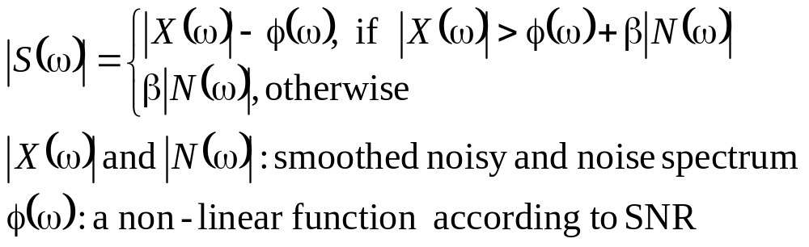
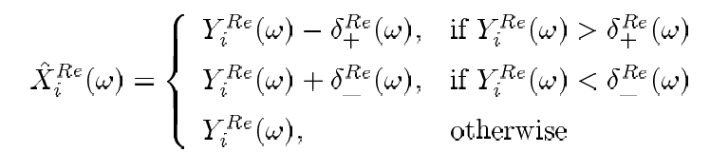
Speech Enhancement Techniques
Approach 2 : Nonlinear Spectral Subtraction (NSS)
Approach 3 : Coherent Spectral Modification (CSM)
  attempts to reduce the distortion due to noise by modifying the complex speech spectrum
  For Real part : (similar for imaginary part)
β|N(ω)|+φ
0
|X(ω)|
β|N(ω)|
0
|S(ω)|
δ₋
δ₊
XRe(ω)
0

Slide 10
Speech Enhancement Techniques
CSM vs. SS
  SS subtracts the average noise magnitude spectrum, while CSM operates coherently on the real and imaginary parts. The problem of negative magnitudes in SS does not arise.
  Independent correction factors are estimated for the positive and negative values of the real and imaginary spectra providing 4 degrees of freedom for correction, while SS only use a single correction factor for each frequency

Slide 11
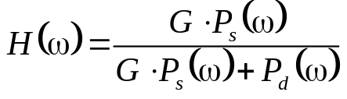
Speech Enhancement Techniques
Approach 4 : Hypothesized Wiener Filtering (HWF)
  Characteristics :
    operates on Cepstral domain
    an optimal filter in the least square sense is obtained in the Linear domain, which is a simple offset of the means in the Cepstral domain
  Method:
    the Power Spectral Density (PSD) estimates of the clean frame ( or the model mean ) and background noise frame are computed. They are P_{s}(ω) and P_{d}(ω), respectively.
    A Wiener filter is evaluated according to
    The Cepstral Representation,C_{w} , of H (ω) is calculated.
    The noisy observation vector O_{t} is modified as O_{t} + C_{w}
    or the model mean is modified as μ- C_{w}

Slide 12
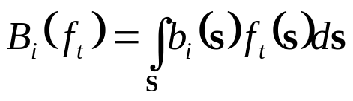
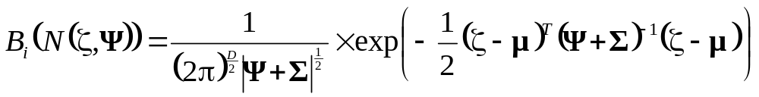
Speech Enhancement Techniques
Approach 5 : Stochastic feature
  the pdf f_{t} of the clean speech component is the desired stochastic feature, and the state output prob. B_{i}(f_{t}) of the speech component is :
  If f_{t} is assumed Gaussian distributed as N(ζ ,Ψ), a parameter set of {ζ ,Ψ} is taken as a stochastic feature. Given that b_{t}(.) is also Gaussian as N(μ , Σ), the state output probability is calculated as :
    the calculation is straight-forward and doesn’t need to integrate over the entire signal space
    Compared to spectral or cepstral mean subtraction, the introduction of Ψ is the most important difference

Slide 13
Speech Enhancement Techniques
Stochastic feature (Cont.)
  In the cepstral domain, how to obtain the pdf of the estimated clean speech component in each noisy speech observation?
Noisy speech
N power spectral
vectors
LOG
Filter Bank
N log power
spectral
vectors
DCT
Noise Buffer
(noise data
during N frames)
N cepstral vectors
Calculation
of mean and
covariance
Spectral subtraction
Stochastic feature : f_{t}

Slide 14
Model-based Noise Compensation Techniques
Approach 1 : Parallel Model Combination (PMC):
  primarily handling the problem of additive noise
  performed on parameters in cepstral domain
  allowing both the means and variances of a model set to be modified
  generating noisy-speech-like models by combining clean speech HMM’s and a noise HMM
Parameters used :
  the clean speech
  models
  a noise model
Noise HMM
Clean speech HMM
Corrupt speech HMM
Cepstral domain
C⁻¹
C⁻¹
C
exp
exp
log
Model combination
Linear Spectral domain

Slide 15

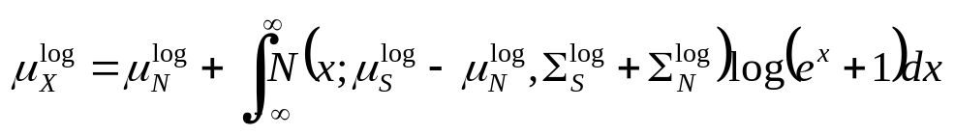
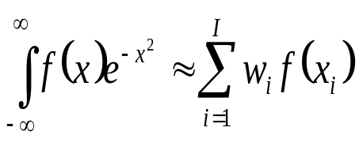
Parallel Model Combination (PMC)
Perform the model combination in the Log-Spectral Domain :
  Log_Add Approximation :
  Numerical Integration :
  in the log-spectral domain, the noisy signal is the nonlinear combination of the clean signal and noise :
  X^{log}=log(X)=log(S+N)=log(exp(S^{log})+exp(N^{log}))
  = N^{log} +log(exp(S^{log} - N^{log})+1)
  ∴
  The integration can be approximated numerically as follows :
where x_{i} and w_{i} are given by the Gauss-Hermite abscissa and
weights respectively

Slide 16

Parallel Model Combination (PMC)
Perform the model combination in the Linear-Spectral Domain (Data_Driven PMC):
Noise HMM
Noisy speech HMM
Clean speech
HMM
Cepstral domain
Generate samples
Domain transform
Linear spectral domain

Slide 17
















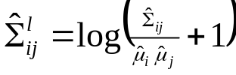
Parallel Model Combination (PMC)
The steps of Parallel Model Combination (Log-Normal Approximation) :
Log-spectral domain
Linear spectral domain
Cepstral domain
Noise HMM’s
Clean speech HMM’s
Noisy speech HMM’s

Slide 18
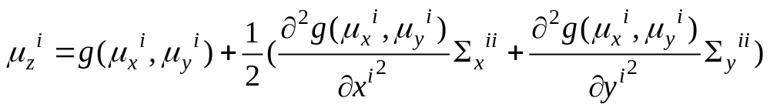
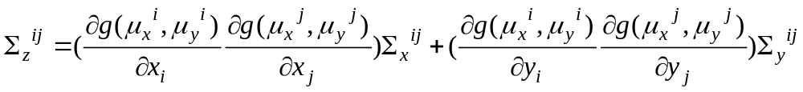
Model-based Noise Compensation Techniques
Approach 2 : Taylor Series Expansion (TSE) Approach :
  Similar to PMC, the noisy-speech-like models is generated by combining of clean speech HMM’s and the noise HMM
  Unlike PMC, the TSE approach combines the parameters of clean speech HMM’s and the noise HMM linearly in the log-spectral domain
  Given a nonlinear function z=g(x, y), the mean and covariance of z can be linearly approximated as :

Slide 19
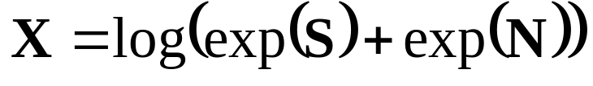
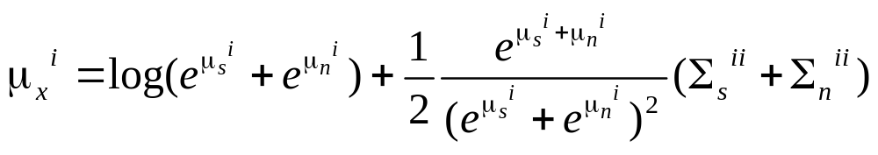
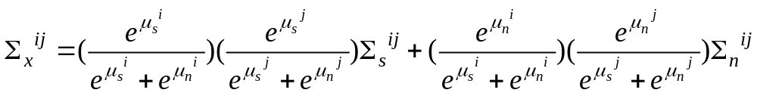
Taylor Series Expansion (TSE) Approach
In the log-spectral domain, the mismatch function x for speech s and additive noise n is :
therefore, the mean and covariance of x can be linearly approximated as :

Slide 20
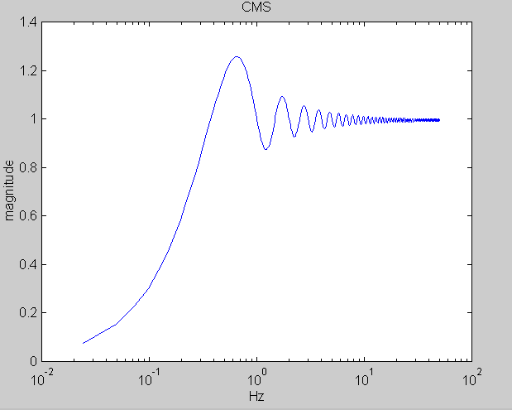
Inherently Robust Features
robust representation of speech signals that is less influenced by additive or channel noise
After the feature representation is decided, the recognition models need to be trained using the new form of features
Approach 1 : Cepstral Mean Subtraction (CMS)
  Originally designed for channel normalization, but found also effective in noise robustness
  If x(n)=h(n)*s(n), then
  cepstral domain : C_{x}(n)=C_{h}(n)+C_{s}(n)
  Assume E{C_{s}(n)} is zero, then the channel
  cepstrum E {C_{h}(n)} is merely the mean of the
  final speech cepstrum E {C_{x}(n)}
  The feature vector is C_{cms}(n) = C_{x}(n) - E {C_{h} (n)}

Slide 21
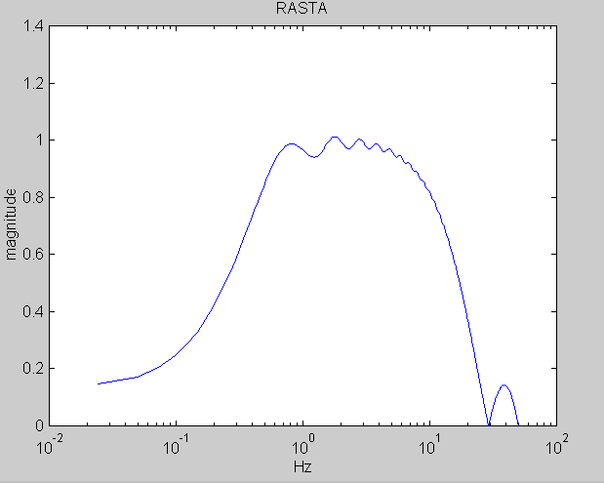
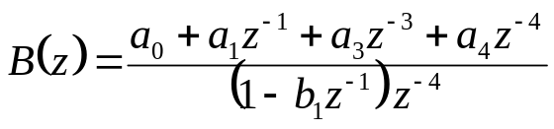
Inherently Robust Features
Approach 2 : RASTA (Relative Spectral) processing :
  Assumption :
  the rate of change of nonliguistic components in speech often lies outside the typical rate of the change of the vocal-tract shape.
  Effect:
  this method suppresses the spectral components that change more slowly or quickly than the typical rate of change of speech
  Time-filtering of each critical band y_{i}(n)
quefrency
B(z)
B(z)
MFCC stream y_{t}
B(z)
Frame index

Slide 22
Principal Component Analysis
Principal Component Analysis (PCA) :
  Widely applied for the data analysis and dimensionality reduction
  In order to derive the most “expressive” feature
  Criterion :
  for a zero mean r.v. x∈R^{N}, find k (k≤N) orthonormal vectors {e₁, e₂,…, e_{k}} so that
  (1) var(e₁^{T} x)=max
  (2) var(e_{i}^{T} x)=max
  subject to e_{i}⊥ e_{i-1} ⊥…… ⊥e₁ 2≤ i ≤k
  {e₁, e₂,…, e_{k}} are in fact the eigenvectors
  of the covariance matrix for x
  corresponding to the largest k eigenvalues
  Final r.v y ∈R^{k} : the linear transform
  (projection) of the original r.v., y=Ax
  A=[e₁ e_{2 ……} e_{k}]
data
Principal axis

Slide 23
Principal Component Analysis
Properties of PCA
  The components of y are mutually uncorrelated
  E{y_{i}y_{j}}=E{(e_{i}^{T}x) (e_{j}^{T}x)^{T}}=E{(e_{i}^{T}x) (x^{T}e_{j})}=e_{i}^{T}E{xx^{T}} e_{j} =e_{i}^{T}Σ_{x}e_{j}
  =e_{i}^{T}( λ₁e₁e₁^{T} +λ₂e₂e₂^{T} +……+ λ_{N}e_{N}e_{N}^{T}) e_{j}=0, i≠j
  ∴ the covariance of y is diagonal
  The error power between the original vector x and the projected x’ is minimum
  x’=(e₁^{T}x)e₁+ (e₂^{T}x)e₂ + ……+(e_{k}^{T}x)e_{k} (Note : x’∈R^{N})
  error r.v : x-x’= (e_{k+1}^{T}x)e_{k+1}+ (e_{k+2}^{T}x)e_{k+2} + ……+(e_{N}^{T}x)e_{N}
  E((x-x’)^{T}(x-x’))=E((e_{k+1}^{T}x) e_{k+1}^{T}e_{k+1} (e_{k+1}^{T}x))+……+E((e_{N}^{T}x) e_{N}^{T}e_{N} (e_{N}^{T}x))
  =var(e_{k+1}^{T}x)+ var(e_{k+2}^{T}x)+…… var(e_{N}^{T}x) ➔minimum

Slide 24
PCA Applied in Inherently Robust Features
Application 1 : the linear transform of the original features
Original feature stream y_{t}
Frame index
A^{T}
A^{T}
A^{T}
A^{T}
The columns of A are the
“first k” eigenvectors of Σ_{y}
z_{t}= A^{T}y_{t}
transformed feature
stream z_{t}
Frame index

Slide 25
PCA Applied in Inherently Robust Features
Application 2 : PCA-derived temporal filter
quefrency
B₁(z)
B₂(z)
Original feature
stream y_{t}
B_{n}(z)
Frame index
The impulse response of B_{k}(z) is one of the
eigenvectors of the covariance for z_{k}
L
z_{k}(1)
z_{k}(2)
z_{k}(3)

Slide 26
PCA Applied in Inherently Robust Features
Application 3 : PCA-derived filter bank
Power spectrum
obtained by DFT
x₁
x₂
x₃
h₁
h₂
h_{k} is one of the eigenvectors
of the covariance for x_{k}
h₃

Slide 27
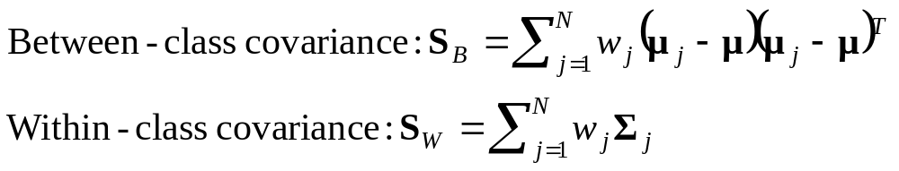
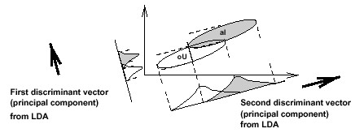
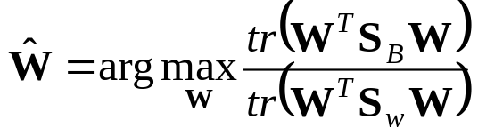
Linear Discriminative Analysis
Linear Discriminative Analysis (LDA)
  Widely applied for the pattern classification
  In order to derive the most “discriminative” feature
  Criterion : assume w_{j}, μ_{j} and Σ_{j} are the weight, mean and covariance of class j, j=1……N. Two matrices are defined as:
  Find W=[w₁ w₂ ……w_{k}]
  such that
  The columns of W are the
  eigenvectors of S_{w}⁻¹S_{B}
  having the largest eigenvalues

Slide 28
Minimum Classification Error
Minimum Classification Error (MCE):
  General Objective : find an optimal feature presentation or an optimal recognition model to minimize the expected error of classification
  The recognizer is often operated under the following decision rule :
  C(X)=C_{i} if g_{i}(X,Λ)=max_{j} g_{j}(X,Λ)
  Λ={λ^{(i)}}_{i=1……M} (M models, classes), X : observations,
  g_{i}(X,Λ): class conditioned likelihood function, for example,
  g_{i}(X,Λ)=P(X|λ^{(i)})
  Traditional Training Criterion :
  find λ^{(i)} such that P(X|λ^{(i)}) is maximum (Maximum Likelihood) if X ∈C_{i}
    This criterion does not always lead to minimum classification error, since it doesn't consider the mutual relationship between different classes
    For example, it’s possible that P(X|λ^{(i)}) is maximum but X ∉C_{i}

Slide 29
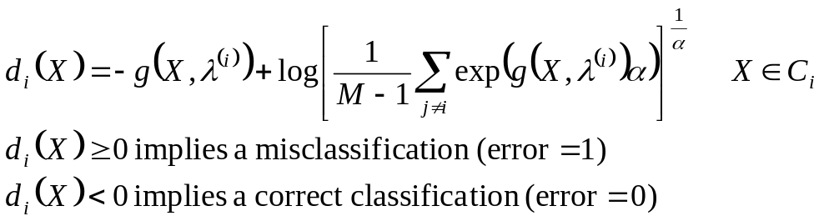
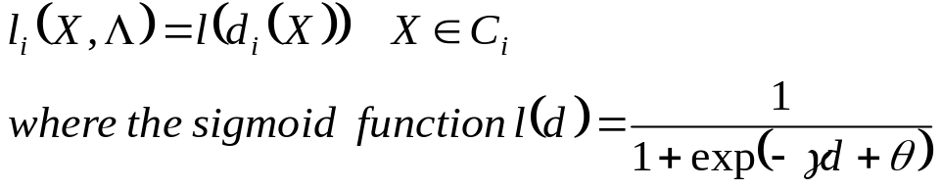
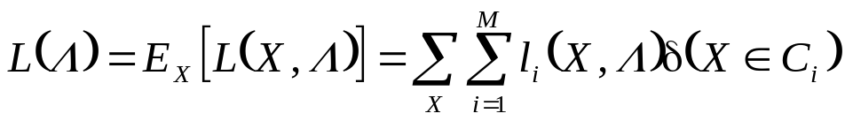
Minimum Classification Error
Minimum Classification Error (MCE) (Cont.):
  One form of the class misclassification measure :
  A continuous loss function is defined as follows :
  Classifier performance measure :

Slide 30
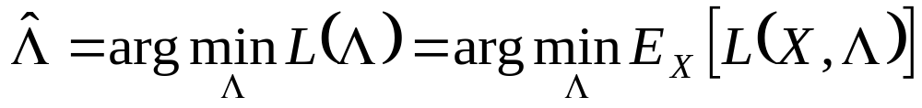
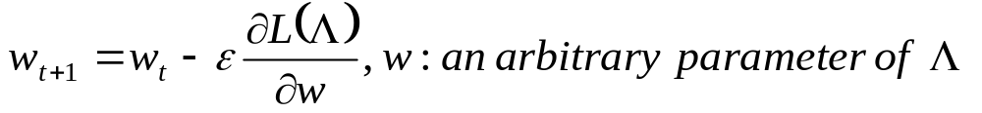
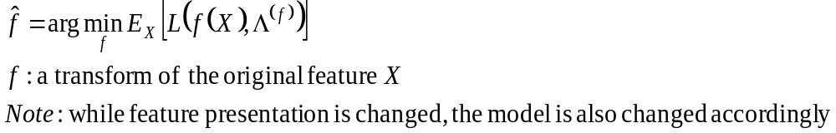
Minimum Classification Error
Using MCE in model training :
  Find Λ such that
  the above objective function in general cannot be minimized directly but the local minimum can be achieved using gradient decent algorithm
Using MCE in robust feature representation

